Slide 1

Zomato Data Analysis
Daithiya Sudan K S
10/02/2024

Slide 2
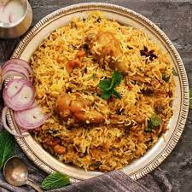
About Zomato
Costliest order placed
It was an astonishing Rs.2 lakh order. To be precise it was a Rs.1,99,950 order. Interestingly, the person who ordered also got a discount, enough to buy a new iPhone 12 Mini.
Did you know? Zomato’s most ordered dish in India is Biryani! There were over 44 lakh orders placed on Zomato only during the pandemic 2020. It is like Zomato delivered 22 biryanis every minute

Slide 3

Data Overview
This dataset contains data of about 9 years from 2010 to 2018.
Total number of restaurants: 8457 across all over the globe.
Total number of restaurants in India: 7559 restaurants
Average rating for the restaurants: 3.4 out of 5
Average cost for two people: $10.79
Data Cleaning and Processing:
Removed all the empty records and records where there was no votes registered.
Added a new column to normalize the average cost for two to a single currency
value. i.e., to US dollars.
Initialized the average rating to the records where there was no rating recorded.
Added a column to define range in which the restaurant’s rating falls.

Slide 4
Analytical Approach
Data cleaning:
Removed all the redundant records.
Filled all the empty numeric cells with average of that column.
Data enhancement:
Included columns separately for year, month and day of opening from the datekey_opening column.
Included one column to define the range in which the restaurant’s rating falls.
Used VLOOKUP to get the country name based on the country code from another sheet.
Descriptive Analysis:
Created multiple pivot tables to analyze the metrics in a visual manner such as restaurants in every country and restaurants opened every year.
Segmentation:
Included slicers and timelines to filter and sort data as per the business requirements.
Visualization:
Included pivot charts to visualize the data from the pivot tables for interactivity.

Slide 5
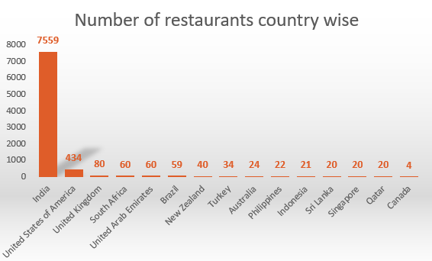
Restaurants country wise
According to the data, India has the highest number of restaurants with the
count of 7559 and followed by USA with 434 restaurants.
Canada has the least number of restaurants with 4 as the count.
Places such as Australia, Philippines, Indonesia, Sri Lanka, Singapore, Qatar,
Canada can be considered to open a new restaurants considering the less
competition in those areas.

Slide 6
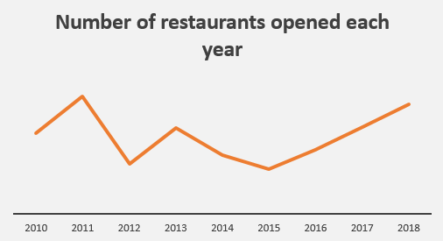
Restaurants opened every year
The highest number of restaurants were opened in the year 2011 (981 restaurants) and the least number of restaurants were opened in the year 2015(906 restaurants).
There was a dip in 2012 where the number of restaurants opened decreased exponentially.
Ever since there has been a steady growth in the number of restaurants opened every year.

Slide 7
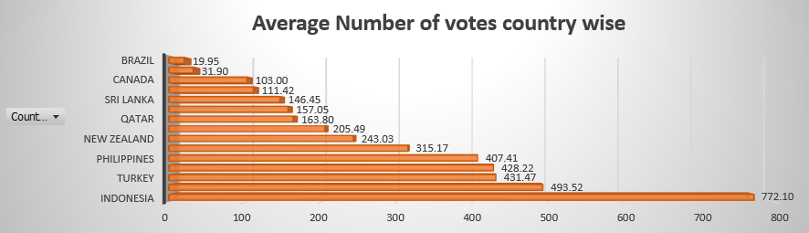
Average Votes
Indonesia has the highest average for votes whereas Brazil has the least average votes.
Even though India has highest number of restaurants opened over the years, it’s average votes looks in the mid-way. This could mean something which should be considered while opening a restaurant.

Slide 8
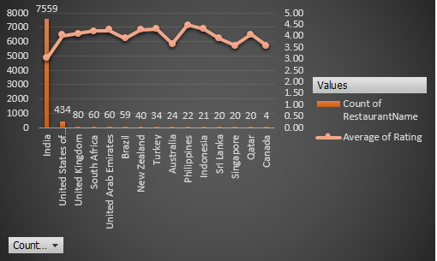
Suitable countries
It is evident that in the below countries the competition is less and also the average rating is less. So if the business decides to start a restaurant in the mentioned countries it is likely to gain success.
Below are the country names:
Canada, Qatar, Singapore, Sri Lanka, Australia, India.
Even though India has the most number of restaurants, the average rating for those restaurants barely crosses 3 rating.
Running a quality restaurant with quality food in India will gain a good rating from the customers.
In other mentioned countries the number of restaurants available is very less which is good sign for the management to decide according to the business needs. Regardless of the above places, the business will be a success if they can provide quality food.

Slide 9
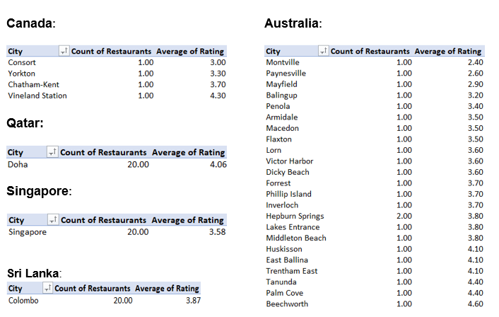
Suitable Cities
Considering only the cities where there are less than 10 restaurants and average rating less than or equal to 3 we find out the least competing cities where a new restaurant can be opened.
After filtering the data, the cities in which the restaurant could be opened are:
Consort (Canada)
Singapore (Singapore)
Mayfield, Montville, Balingup, Paynesville (Australia)
Nagpur, Nashik, Jaipur, Indore, Puducherry, Patna, Aurangabad, Varanasi, Ranchi, Allahabad (India)
Colombo (Sri Lanka)
Doha (Qatar)

Slide 10
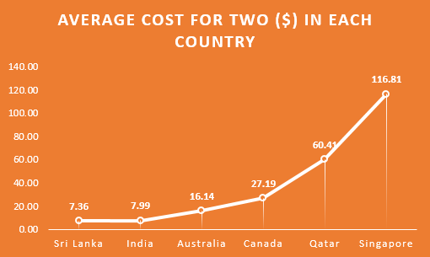
Average cost for two
Least average cost for two people is in Sri Lanka with costing 7.36 US dollars.
Highest average cost for two people in Singapore with costing 116.81 US dollars respectively.
From the chart we can recommend the business to open a restaurant either in Sri Lanka or in India as the average cost for two is less than 10 dollars.
Considering all the factors such as groceries and rent, it is less expensive for the business and will help in generating more profits.

Slide 11
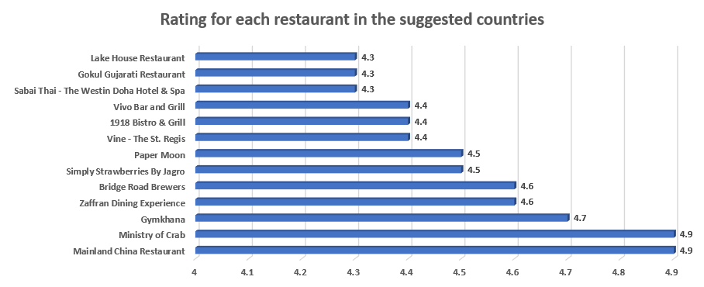
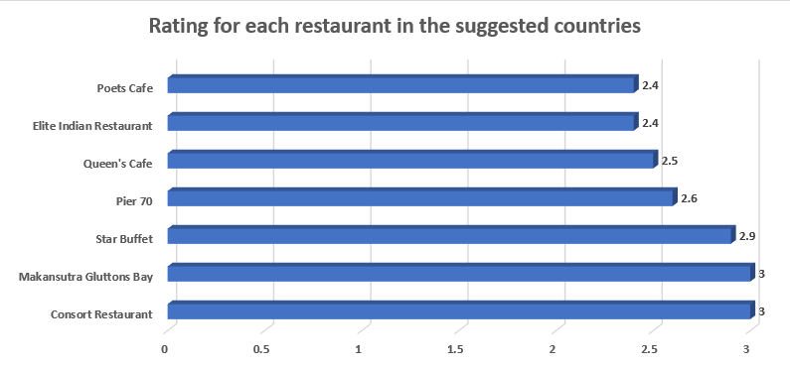
Rating of restaurants
The visual on the left side represents the biggest competitors for the management in Australia, Canada, Singapore, Sri Lanka and Qatar.
Considering only the restaurants above 4.5 rating as the competitors, there are 13 restaurants which could possibly be the competitors.
The visual on the right side represents the restaurants which come under lower bracket (1-2, 2-3) and there are totally 7 restaurants in the suggested countries.

Slide 12
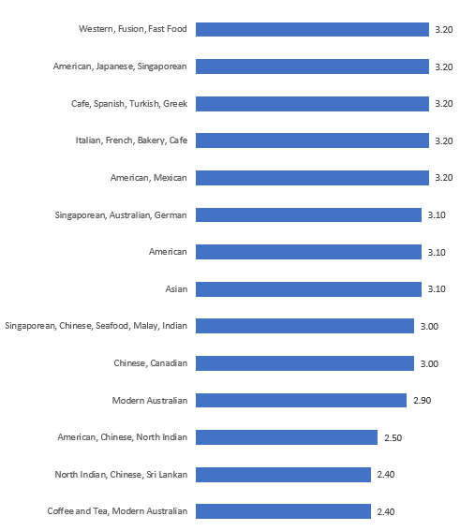
CUISINES
Considering the 10 least rated cuisines, the least rated cuisine among them is “Coffee and Tea, Modern Australian” with a rating of 2.40 and the cuisine “Western, Fusion, Fast Food” is with a rating of 3.20.
These are the cuisines that a newly opening restaurant should concentrate more to gain better feedback when compared to others.
If a newly opening restaurant is to concentrate more on other cuisines it is hard to gain a better feedback as they already have a better rating.

Slide 13
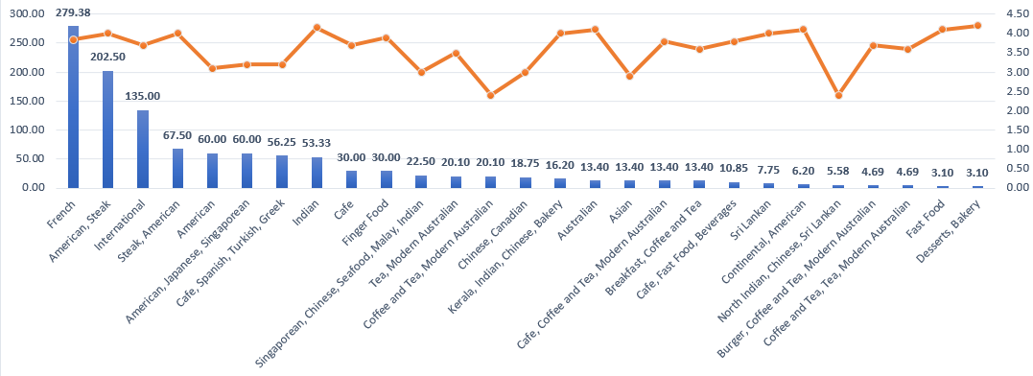
Average rate of cuisines
According to the given data, it is evident that the rating and rates of cuisines are not correlated.
A cuisine with average cost of $60 has the same rating as when compared with a cuisine that has an average cost of $22.5
The rate of cuisine does not necessarily be higher. It is better to consider the cuisines which can be costed at a medium cost.

Slide 14
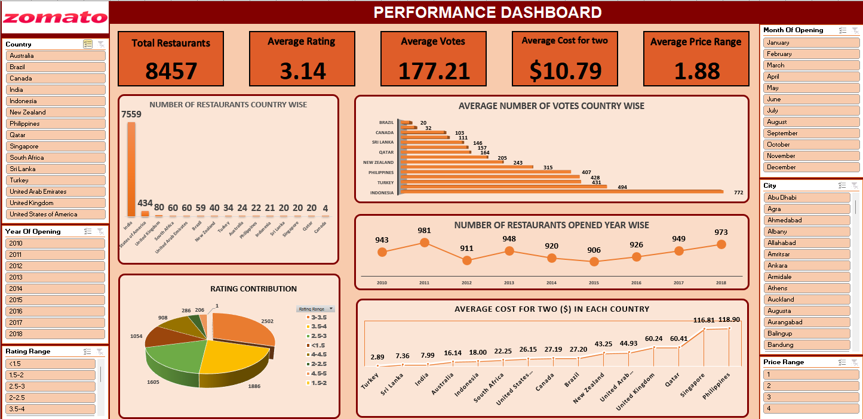
Dashboard

Slide 15

CONCLUSION
Identified the countries with least competition and cities with least number of restaurants.
If the business decides to start a restaurant with quality food in those regions, it is more likely to see good recognition among the people due to less competition.
Rating of the restaurants in those regions is also averagely bad which is a good sign for the business to start at those regions.

